Slide 1
De bronze à légendaire
Comment réussir vos IA de Bot

Slide 2




ABOUT ME
GRÉGORY RIBÉRON aka MANWE
DEV LEAD UI/UX
MANWE
@RiberonG
Manwe56

Slide 3
Past contests results
CHALLENGE | DATE | RANK
PLANET WARS | 01 Dec 2010 | 31 / 4617
ANT WARS | 19 Dec 2011 | 75 / 7897
TRON | 10 Jan 2014 | 4 / 672
GAME OF DRONES | 14 Mar 2014 | 11 / 621
POKER CHIP RACE | 10 Sep 2014 | 4 / 449 1 / 29
PLATINUM RIFT | 08 Nov 2014 | 46 / 1080
THE GREAT ESCAPE | 06 Feb 2015 | 49 / 1153
CHALLENGE | DATE | RANK
BACK TO THE CODE | 26 Sep 2015 | 95 / 2017
CODERS STRIKE BACK | 27 Feb 2016 | 128 /2530
SMASH THE CODE | 30 Apr 2016 | 67 / 2493
CODE BUSTERS | 25 Jun 2016 | 53 / 1979
HYPERSONIC | 24 Sep 2016 | 98 / 2715
FANTASTIC BITS | 26 Nov 2016 | 19 / 2399
GHOST IN THE CELL | 25 Feb 2017 | 74 / 3508
Notes:
Organiser : Google AI Challenge - Codingame

Slide 4





CODINGAME LEAGUE SYSTEM
663
1383
638
601
223
3508

Slide 5
SUMMARY
INTRO
TIPS
TYPE OF GAMES AND ALGORITHM
GOING FURTHER

Slide 6
CONTEXT
WORLDWIDE COMPETITION
ANY LANGUAGE
Bot communicates via standard IO
NO THIRD PARTY SOFTWARE
Thousands of contestants
10 days
SINGLE FILE
YOUR CODE AGAINST THE OTHERS
PERFORMANCE : <100MS PER TURN

Slide 7
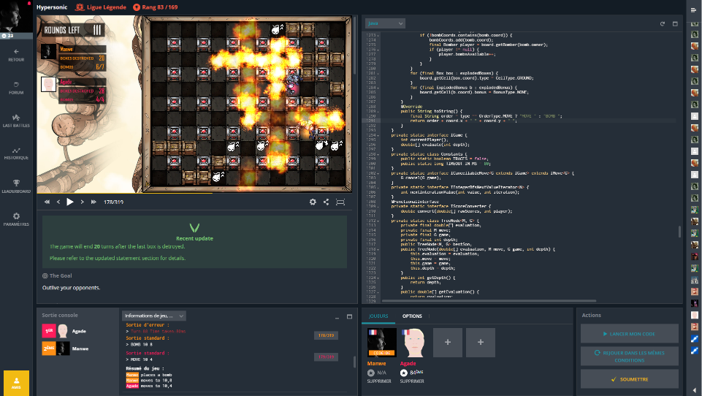
CONTEXT
The game
Your code
Rules
Logs
Opponents

Slide 8
TIPS
TIPS

Slide 9

TRAIN

Slide 10
TIME TO INVEST
First bot
Few minutes
Top 50%
Few hours
Top 100
15/20 hours

Slide 11
START SIMPLE
Design game mechanism
Simple straight forward AI

Slide 12
USUAL STRUCTURE OF BOT
Parsing
High level
AI
Game
Rules
Evaluation
AI Algorithm

Slide 13
TESTS TESTS TESTS!!
Game logic
Evaluation
Unit
or reuse
AI algorithm
Log
Parsing
High level AI
System tests
Secure key features
Unit
Notes:
I won open day because of the tests

Slide 14
PRINT GAME STATE IN THE LOGS
String gameSetup="15\n105\n0 5 6\n0 11 6\n0 7 7\n0 13 4\n0 10 2\n0 8 7\n0 3 2\n0 9 2\n0 14 4\n0 4 2\n0 6 6\n0 2 1\n0 1 1\n0 12 6\n1 5 5\n1 11 7\n1 7 7\n1 13 5\n1 10 1\n1 8 8\n1 3 2\n1 9 3\n1 14 5\n1 4 4\n1 6 7\n1 2 4\n1 12 6\n2 5 7\n2 11 6\n2 7 8\n2 13 5\n2 10 3\n2 8 7\n2 3 4\n2 9 1\n2 14 5\n2 4 2\n2 6 5\n2 12 7\n3 5 2\n3 11 4\n3 7 4\n3 13 2\n3 10 4\n3 8 10\n3 9 2\n3 14 7\n3 4 5\n3 6 9\n3 12 9\n4 5 9\n4 11 9\n4 7 10\n4 13 7\n4 10 2\n4 8 4\n4 9 4\n4 14 2\n4 6 2\n4 12 4\n5 11 4\n5 7 2\n5 13 3\n5 10 8\n5 8 14\n5 9 5\n5 14 11\n5 6 13\n5 12 12\n6 11 12\n6 7 14\n6 13 11\n6 10 5\n6 8 2\n6 9 8\n6 14 3\n6 12 4\n7 11 2\n7 13 2\n7 10 10\n7 8 16\n7 9 5\n7 14 13\n7 12 15\n8 11 15\n8 13 13\n8 10 5\n8 9 10\n8 14 2\n8 12 2\n9 11 3\n9 13 2\n9 10 5\n9 14 7\n9 12 9\n10 11 9\n10 13 7\n10 14 2\n10 12 3\n11 13 1\n11 14 12\n11 12 14\n12 13 12\n12 14 1\n13 14 10\n";
String turnState="24\n0 FACTORY 0 0 0 0 0\n1 FACTORY 1 0 0 0 0\n-1 BOMB 1 -1 1 -1 -1\n2 FACTORY -1 0 0 5 0\n3 FACTORY 1 2 1 0 0\n-1 TROOP -1 0 3 4 1\n-1 TROOP 1 0 3 4 4\n-1 BOMB 1 -1 3 -1 -1\n4 FACTORY -1 3 1 0 0\n-1 TROOP 1 0 4 7 2\n5 FACTORY 0 10 2 0 0\n6 FACTORY 0 10 2 0 0\n-1 TROOP -1 0 6 11 1\n7 FACTORY 0 3 1 0 0\n8 FACTORY 0 3 1 0 0\n-1 TROOP -1 0 8 4 3\n9 FACTORY 1 8 3 0 0\n10 FACTORY 1 3 3 0 0\n11 FACTORY 0 2 1 0 0\n-1 TROOP -1 0 11 3 2\n12 FACTORY 0 2 1 0 0\n-1 TROOP -1 0 12 3 9\n13 FACTORY 0 3 1 0 0\n14 FACTORY 0 3 1 0 0\n";
Game model tests
System tests
Debugging
Notes:
Story of the implementation details of Poker chip race

Slide 15
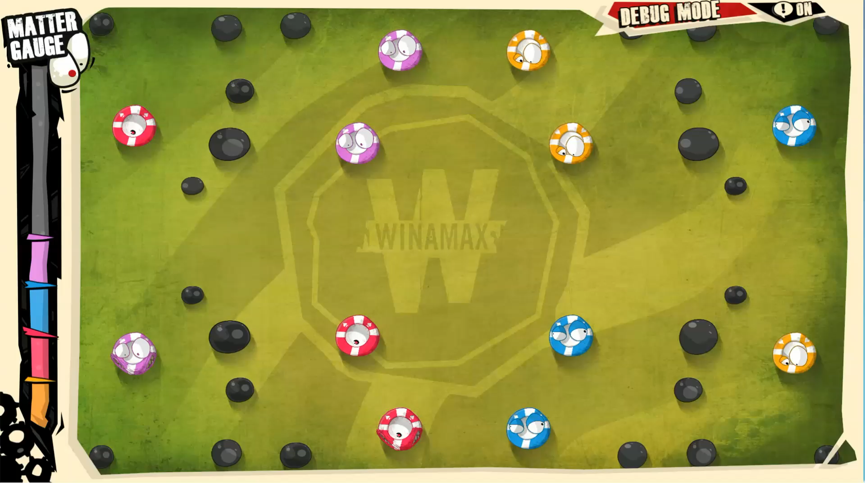
WATCH THE OTHER BOTS, WATCH YOUR BOT
BUGS
Steal best ideas

Slide 16
TIME MANAGEMENT
00 : 00 : 05
Few first hours
Read the subject
Have fun
Main days
Plan cool features
Code code code
Last evening
Watch your bot!
Last hours
Relax!
Watch the leaders and steal great ideas
Implement basic strategies
Use algos
Notes:
Ant wars & submit on last time. No unit tests???

Slide 17


YOUR BEST FRIENDS TO FIND IDEAS:
Previous contests Top player strategies

Slide 18
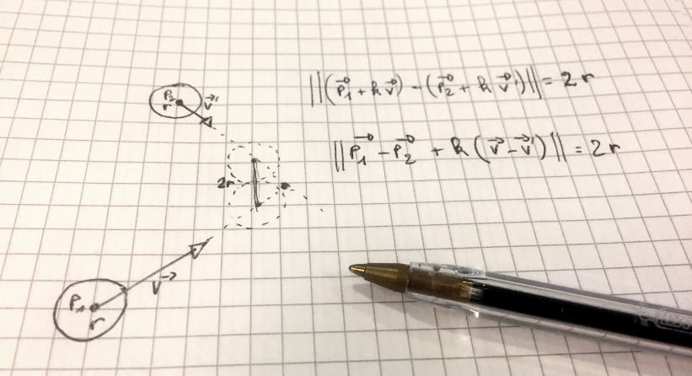
YOUR BEST FRIENDS TO FIND IDEAS:

Slide 19
FEATURES PRIORITIES : BEST RETURN ON INVESTMENT FIRST
Gain
Cost
Gain
Cost
Cost

Slide 20

LEARN TO DROP YOUR « GENIUS » IDEAS
Use an SCM
Use features branch
Give yourself a maximum time on a feature

Slide 21
GAMES & ALGORITHM
TYPES OF GAMES & ALGORITHM

Slide 22
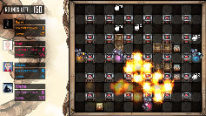
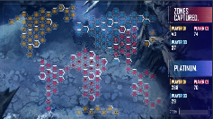
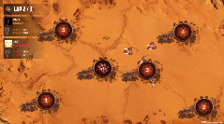
TYPES OF GAMES
Type | Branching factor | Actions per turn | Example
Game Tree | Small | Small | Tic tac toe Hypersonic
Resource Management | High | High | Starcraft Platinum Rift
Simulation | High | Small | Car race CSB

Slide 23
TYPES OF GAMES
Type | Branching factor | Actions per turn | Example
Game Tree | Small | Small | Tic tac toe Hypersonic
Resource Management | High | High | Starcraft Platinum Rift
Simulation | High | Small | Car race CSB

Slide 24
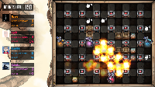
GAME TREE
Turn 1
Turn 2
Wins!
Turn 3
Current state
Wins!
Wins!
Wins!
Wins!

Slide 25
TRAVERSAL STRATEGIES
Fixed depth
Minimax
MaxNTree
Promising first
Monte carlo Tree search

Slide 26
FIXED DEPTH
-2
∞
10
3

Slide 27
FIXED DEPTH
-2
-2
∞
10
3
3

Slide 28
Fixed depth
-2
-2
∞
3
10
3
3

Slide 29
FIXED DEPTH : PRUNNING STRATEGIES
Minimax
Do not explore all branches
Unique branch for opponent
Alpha beta

Slide 30
DEPTH VS EVALUATION FUNCTION
Depth
Evaluation function

Slide 31

FIXED DEPTH : SUICIDAL TENDENCIES

Slide 32
PROMISING FIRST: SELECTION
3/0
5/1
2/1

Slide 33
PROMISING FIRST : EXPANSION
0/0
0/0
3/0
5/1
0/0
2/1

Slide 34
PROMISING FIRST : SIMULATION
WIN
0/0
0/0
3/0
5/1
0/0
2/1

Slide 35
PROMISING FIRST : SIMULATION
1/0
LOST
0/0
3/0
5/1
0/0
2/1

Slide 36
PROMISING FIRST : SIMULATION
2/1
WIN
0/0
3/0
5/1
0/0
2/1

Slide 37
PROMISING FIRST : BACKPROPAGATION
2/1
3/0
7/2
5/1
2/1
2/1

Slide 38
PROMISING FIRST : BACKPROPAGATION
2/1
3/0
7/2
9/3
2/1
2/1

Slide 39
PROMISING FIRST
2/1
3/0
7/2
9/3
2/1
2/1

Slide 40
MONTE CARLO TREE SEARCH
Transition cost
Out of memory
Notes:
Caracteristics:
No evaluation function
Game nodes kept in memory
Reaching end game state
Don’t use if:
Game state transition are costly (CPU cost to reach end state)
Game is not fully known in advance (impossible to reach end state)
Game state cost in memory

Slide 41
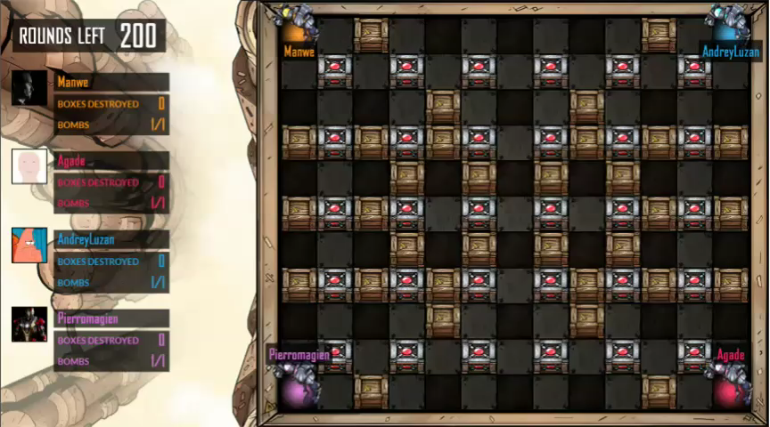
Notes:
Caracteristics:
No evaluation function
Game nodes kept in memory
Reaching end game state
Don’t use if:
Game state transition are costly (CPU cost to reach end state)
Game is not fully known in advance (impossible to reach end state)
Game state cost in memory

Slide 42
TYPES OF GAMES
Type | Branching factor | Actions per turn | Example
Game Tree | Small | Small | Tic tac toe Hypersonic
Resource Management | High | High | Starcraft Platinum Rift
Simulation | High | Small | Car race CSB

Slide 43
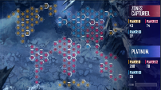
DIFFUSION

Slide 44
DIFFUSION
50
50

Slide 45
DIFFUSION
50
25
25
25
50
25

Slide 46
DIFFUSION
50
25
12
25
12
12
25
50
25
12

Slide 47
DIFFUSION
50
25
12
6
3
25
12
6
1
12
3
0
25
6
3
1
50
25
12
6
3

Slide 48
DIFFUSION
2
5
10
5
2
5
2
5
1
10
2
0
5
2
1
0
5
10
5
2
1

Slide 49
DIFFUSION
50
25
12
6
3
3
6
12
25
50
25
12
6
1
1
3
6
25
12
3
0
0
3
12
x 1
25
6
3
1
x 0
1
6
12
25
50
25
12
6
3
3
6
12
25
50
2
5
10
5
2
0
1
2
1
0
5
2
5
1
1
2
5
1
10
2
0
0
10
2
Movements
x 1
5
2
1
0
1
5
10
5
x 0
5
10
5
2
1
2
5
10
5
2

Slide 50
DIFFUSION
52
30
22
11
5
x 1
30
14
11
2
22
5
0
x 0
30
8
4
1
x 1
55
35
17
8
4
Movements
x 0

Slide 51
DIFFUSION
50
25
12
6
3
3
6
12
25
50
25
12
6
1
1
3
6
25
12
3
0
0
3
12
x 0
25
6
3
1
x 0
1
6
12
25
50
25
12
6
3
3
6
12
25
50
2
5
10
5
2
0
1
2
1
0
5
2
5
1
1
2
5
1
10
2
0
0
10
2
Reinforcements
x 1
5
2
1
0
x -1
1
5
10
5
5
10
5
2
1
2
5
10
5
2

Slide 52
DIFFUSION
2
4
8
4
2
x 0
4
0
0
0
10
-8
-2
x 0
4
-3
-9
-5
x 1
3
5
-5
-3
-1
Reinforcements
x -1

Slide 53
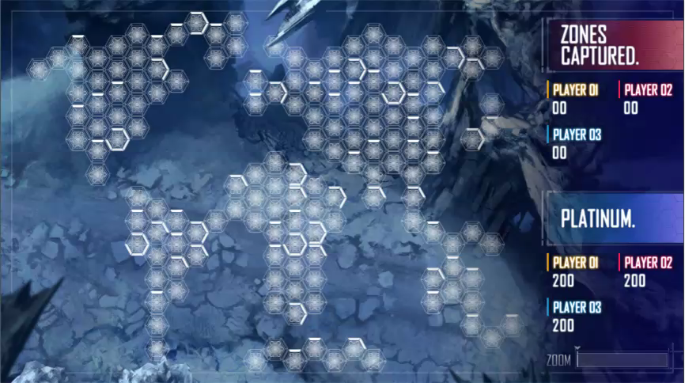

Slide 54
TYPES OF GAMES
Type | Branching factor | Actions per turn | Example
Game Tree | Small | Small | Tic tac toe Hypersonic
Resource Management | High | High | Starcraft Platinum Rift
Simulation | High | Small | Car race CSB

Slide 55
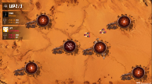
EXAMPLE: CAR RACE
Throttle : [-100; 100]
Steering : [-45; 45]
Notes:
Idée géniale Coders strike back

Slide 56
BAD RANDOM, GOOD RANDOM
Throttle : [-100; 100]
Steering : [-45; 45]
Notes:
Full random usually performs poorely
First turn random then euristic
Change probabilities distribution

Slide 57
BAD RANDOM
Move badRandomMove(Car car, List<Checkpoint> nextCheckpoints) {
int throttle = random.nextInt(THROTTLE_RANGE) + THROTTLE_MIN;
int steering = random.nextInt(STEERING_RANGE) + STEERING_LEFT;
return new Move(throttle, steering);
}

Slide 58
BAD RANDOM
Notes:
Full random usually performs poorely
First turn random then euristic
Change probabilities distribution

Slide 59
BAD RANDOM
Notes:
Full random usually performs poorely
First turn random then euristic
Change probabilities distribution

Slide 60
GOOD RANDOM : USE HEURISTIC FUNCTION
Move enhancedRandom(Car car, List<Checkpoint> nextCheckpoints) {
if (random.nextDouble() < 0.7) {
return heuristicFunction(car, nextCheckpoints);
}
return badRandomMove(car, nextCheckpoints);
}
Notes:
Full random usually performs poorely
First turn random then euristic
Change probabilities distribution

Slide 61
GOOD RANDOM : USE KNOWN GOOD VALUES
Move enhancedRandom(Car car, List<Checkpoint> nextCheckpoints) {
int throttle = 0;
double throttleRandom = random.nextDouble();
if (throttleRandom < 0.6) { // 60% chance full throttle
throttle = 100;
} else if (throttleRandom < 0.7) { // 10% chance full brake
throttle = -100;
} else { // 30% change random
throttle = random.nextInt(THROTTLE_RANGE) + THROTTLE_MIN;
}
…
return new Move(throttle, steering);
}
Notes:
Full random usually performs poorely
First turn random then euristic
Change probabilities distribution

Slide 62
GOOD RANDOM
Notes:
Full random usually performs poorely
First turn random then euristic
Change probabilities distribution

Slide 63
GOOD RANDOM
Notes:
Full random usually performs poorely
First turn random then euristic
Change probabilities distribution

Slide 64
GENETIC ALGORITHM: (GOOD) RANDOM GENERATION
List<Move> generateRandomGenotype(Car car, List<Checkpoint> nextCheckpoints) {
return IntStream.range(0, 5).boxed()
.map(i -> enhancedRandom(car, nextCheckpoints))
.collect(Collectors.toList());
}
Notes:
Full random usually performs poorely
First turn random then euristic
Change probabilities distribution

Slide 65
GENETIC ALGORITHM: MERGE
List<Move> merge(List<Move> first, List<Move> second) {
List<Move> merged = new ArrayList<>();
for (int i = 0; i < first.size(); i++) {
Move firstMove = first.get(i);
Move secondMove = second.get(i);
int meanThrottle = (firstMove.throttle + secondMove.throttle) / 2;
int meanSteering = (firstMove.steering + secondMove.steering) / 2;
merged.add(new Move(meanThrottle, meanSteering));
}
return merged;
}
Notes:
Full random usually performs poorely
First turn random then euristic
Change probabilities distribution

Slide 66
GENETIC ALGORITHM: MUTATE
List<Move> mutate(List<Move> genotype) {
List<Move> merged = new ArrayList<>(genotype.subList(0, 3));
for (int i = 3; i < genotype.size(); i++) {
Move toMutate = genotype.get(i);
merged.add(new Move(toMutate.throttle + random.nextInt(10) - 5,
toMutate.steering + random.nextInt(5) - 2));
}
return merged;
}
Notes:
Full random usually performs poorely
First turn random then euristic
Change probabilities distribution

Slide 67
GENETIC ALGORITHM: SELECTION
Notes:
Full random usually performs poorely
First turn random then euristic
Change probabilities distribution

Slide 68
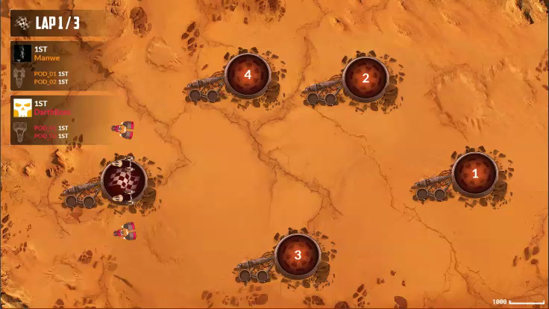

Slide 69
GOING FURTHER
GOING FURTHER

Slide 70
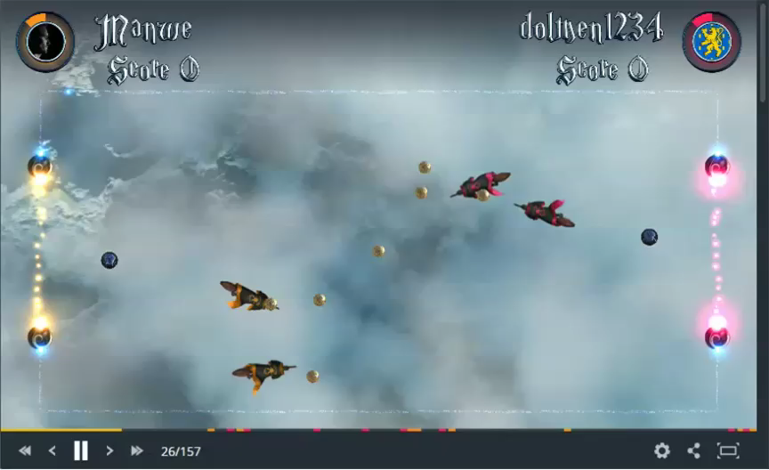
ARTIFICIAL INTELLIGENCE
Notes:
Ton IA elle fait n’importe quoi mais elle gagne a la fin

Slide 71
What about machine learning?

Slide 72
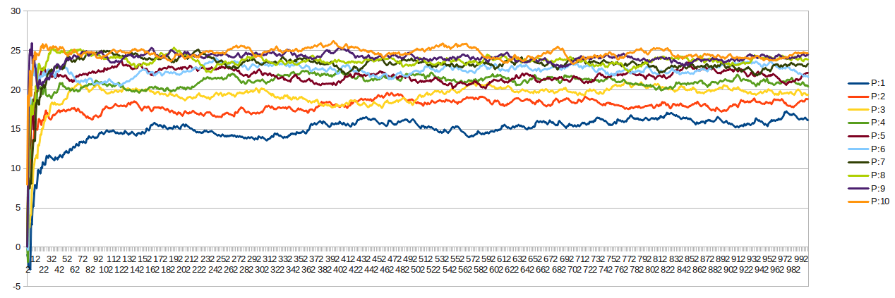
Understanding the leaderboard
=> Before the final round your bot skill is an approximation. Consider a +/-1 point in the precision

Slide 73
Who wins?
Planet wars : Bocsimackó
AI engineer
Ant wars : Xathis
Student
Game of Drones : Loujo
Music teacher
Smash the code: pb4608
Engineer but not in Software

Slide 74
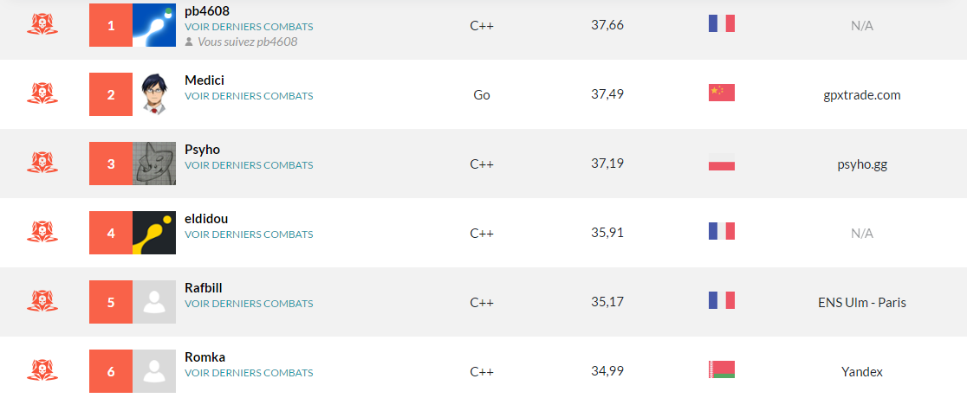
Best language?

Slide 75
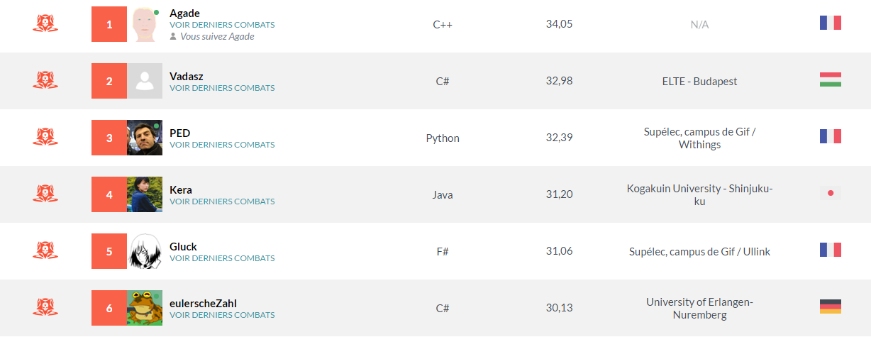
Best language?

Slide 76
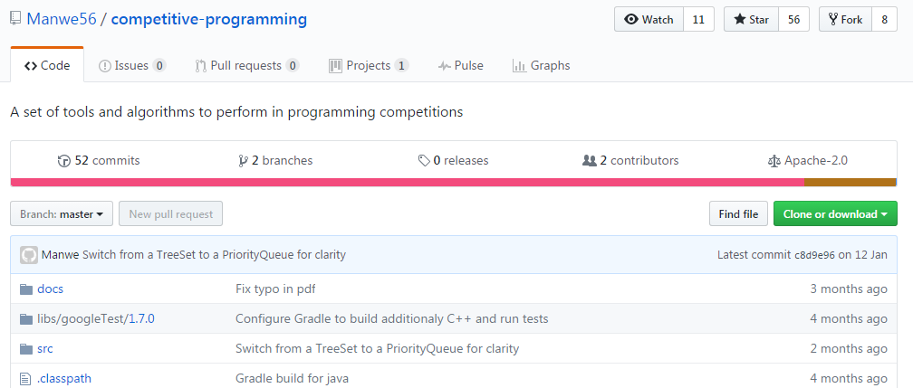
Github

Slide 77

Next challenge starts 14 April!

Slide 78
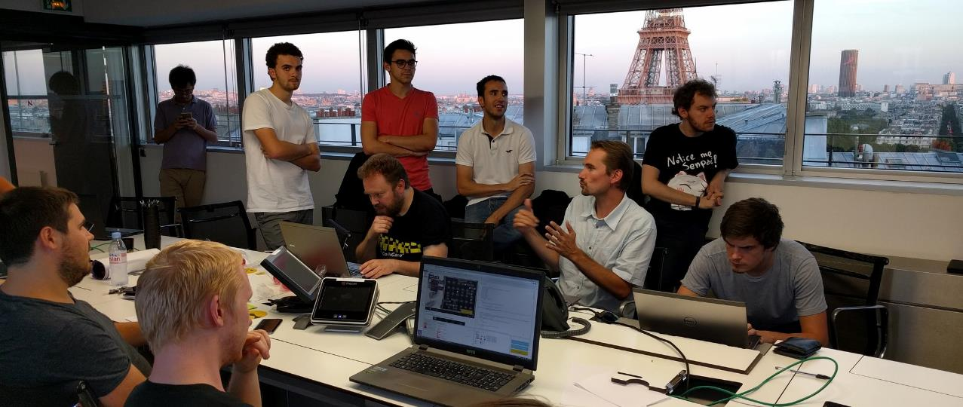
Coding hubs @ MUREX : 20 April

Slide 79

Thanks!!
Notes:
Neumann
reCurse
Agade
Vadasz
a1k0n
Bocsimacko
Xathis
Loujo
Xylo
Magus
Jeff06
Pb4
Ixanezis
Romka
Recar
Manwe

Slide 80
You have no more excuses!
Good luck!!

